Slide 1
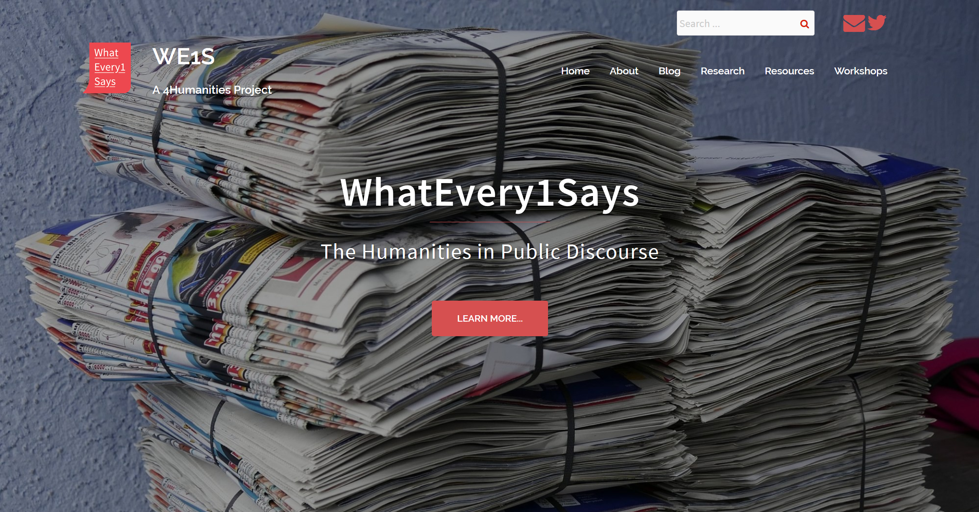

Slide 2
Origin of Project

Slide 3
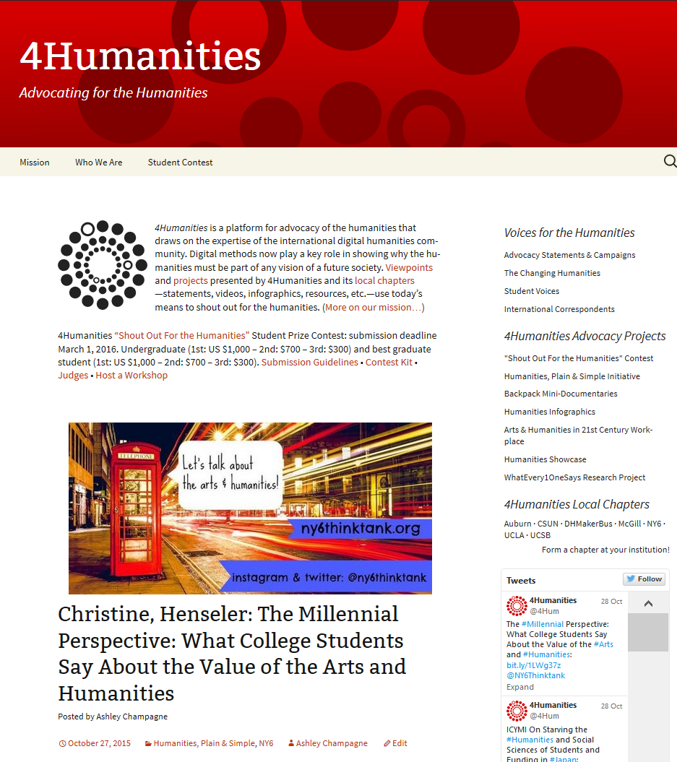
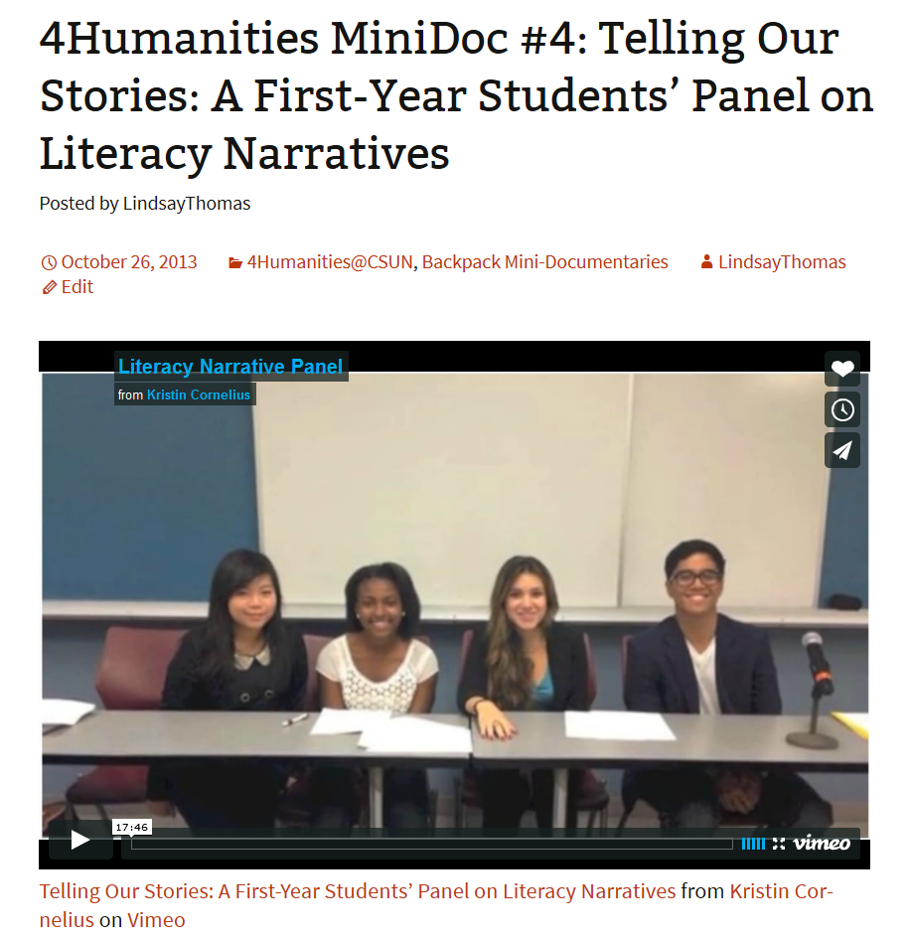
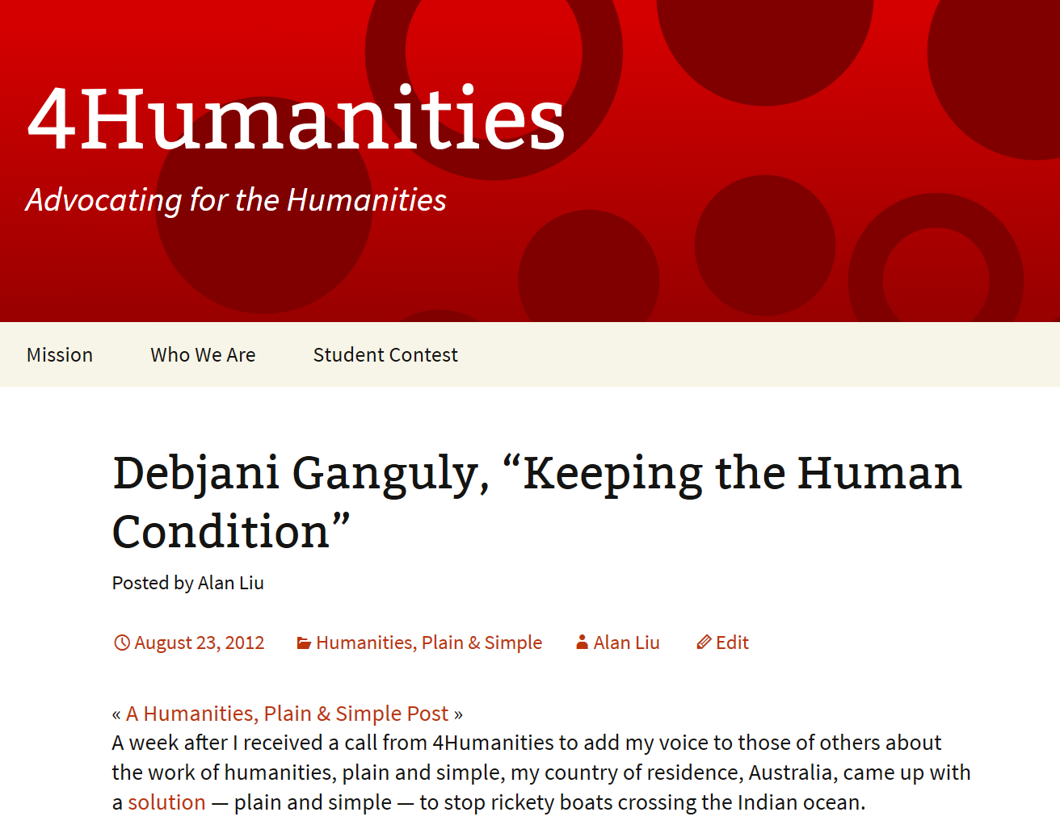
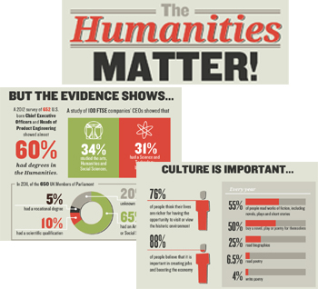
4Humanities.org
Research-driven Advocacy
Digital Humanities Methods

Slide 4
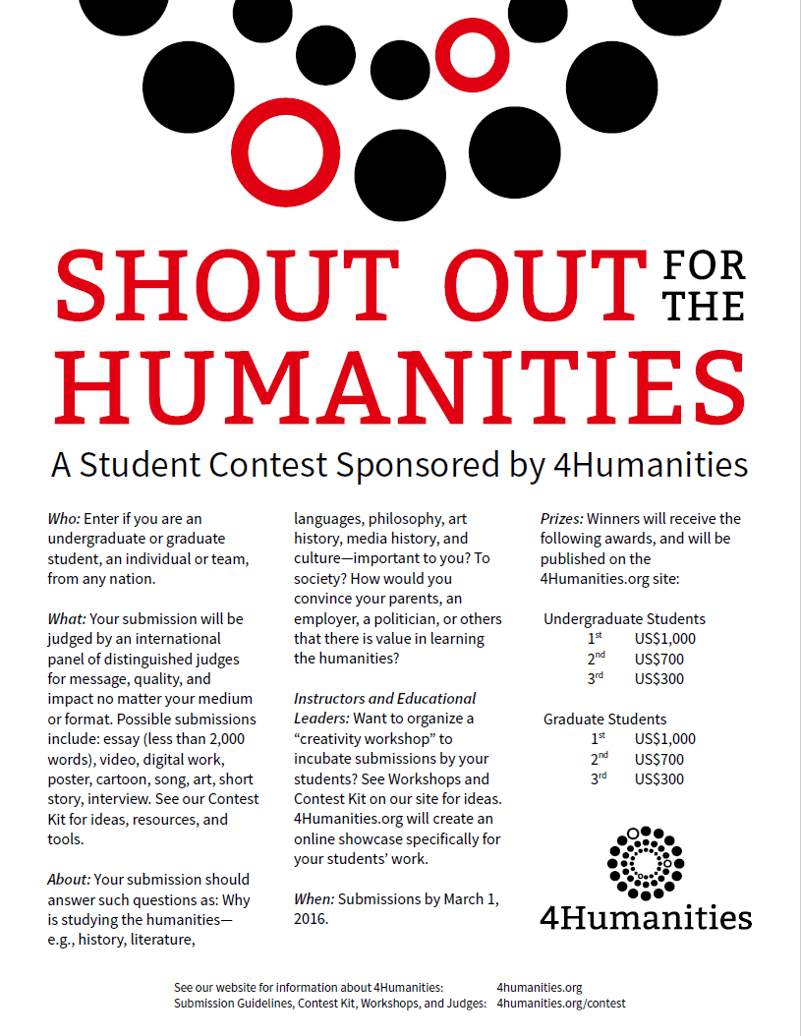
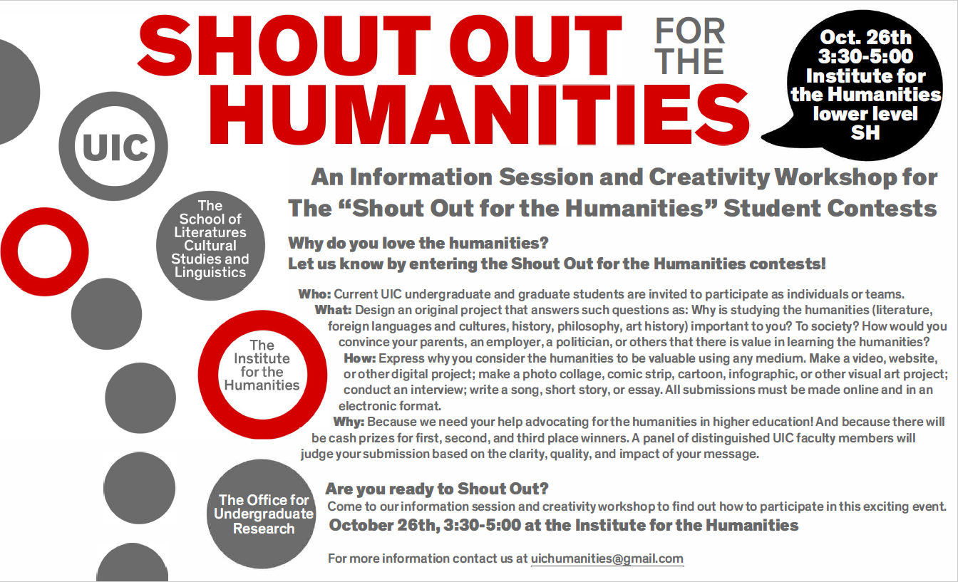
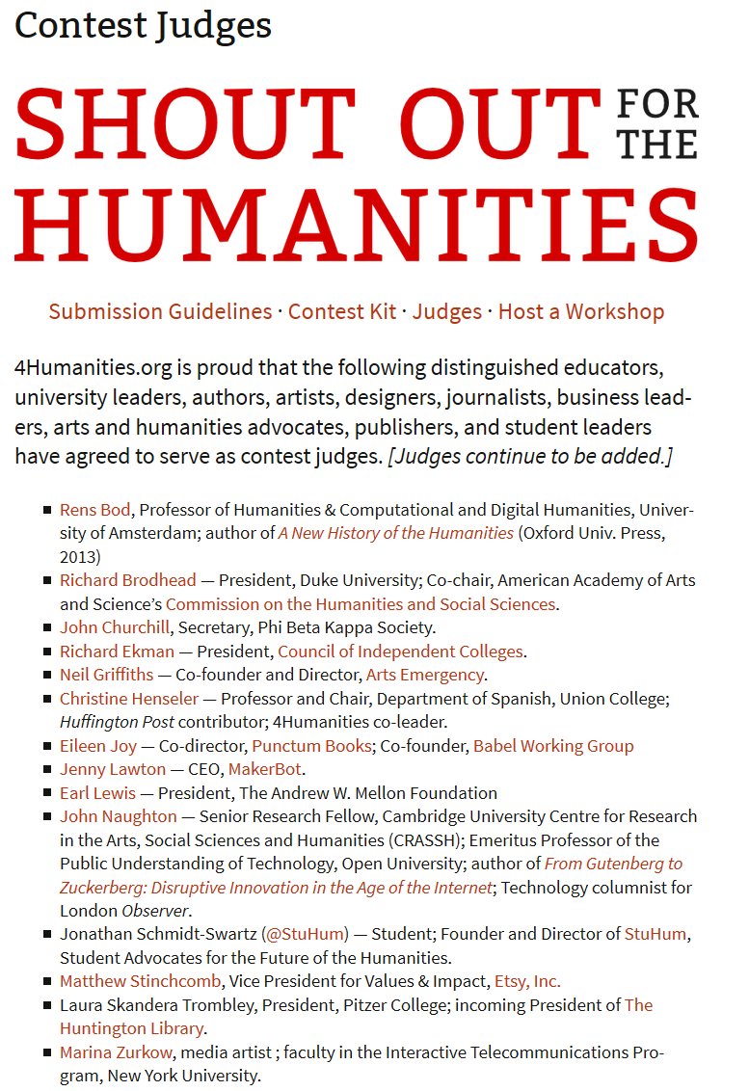
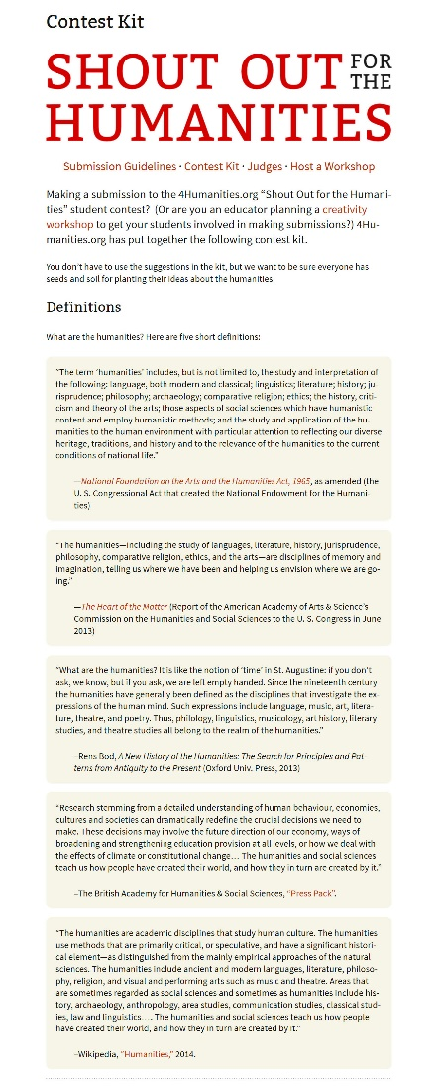
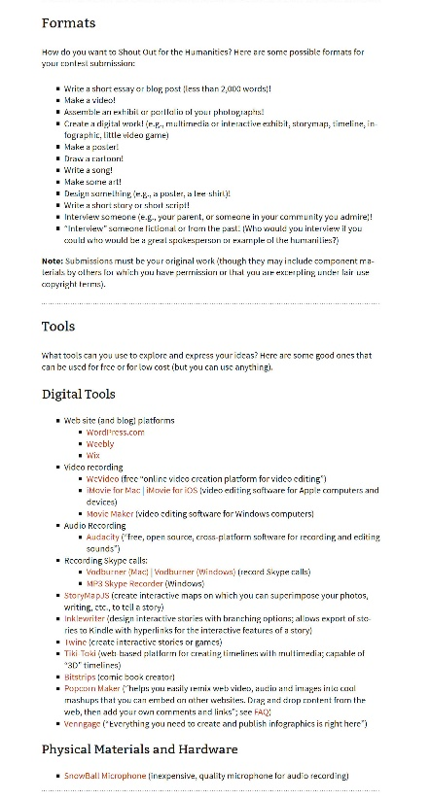
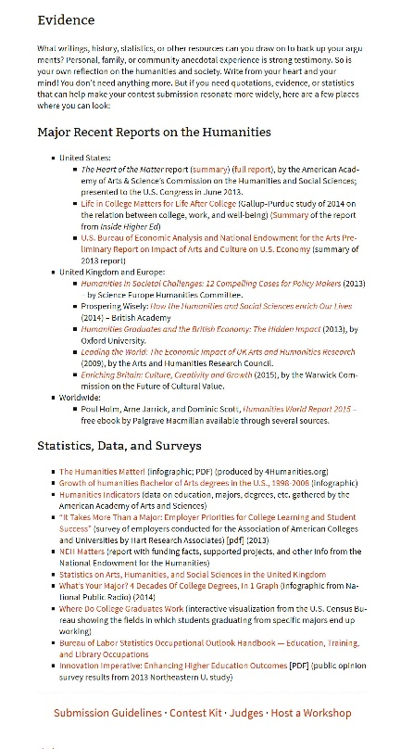
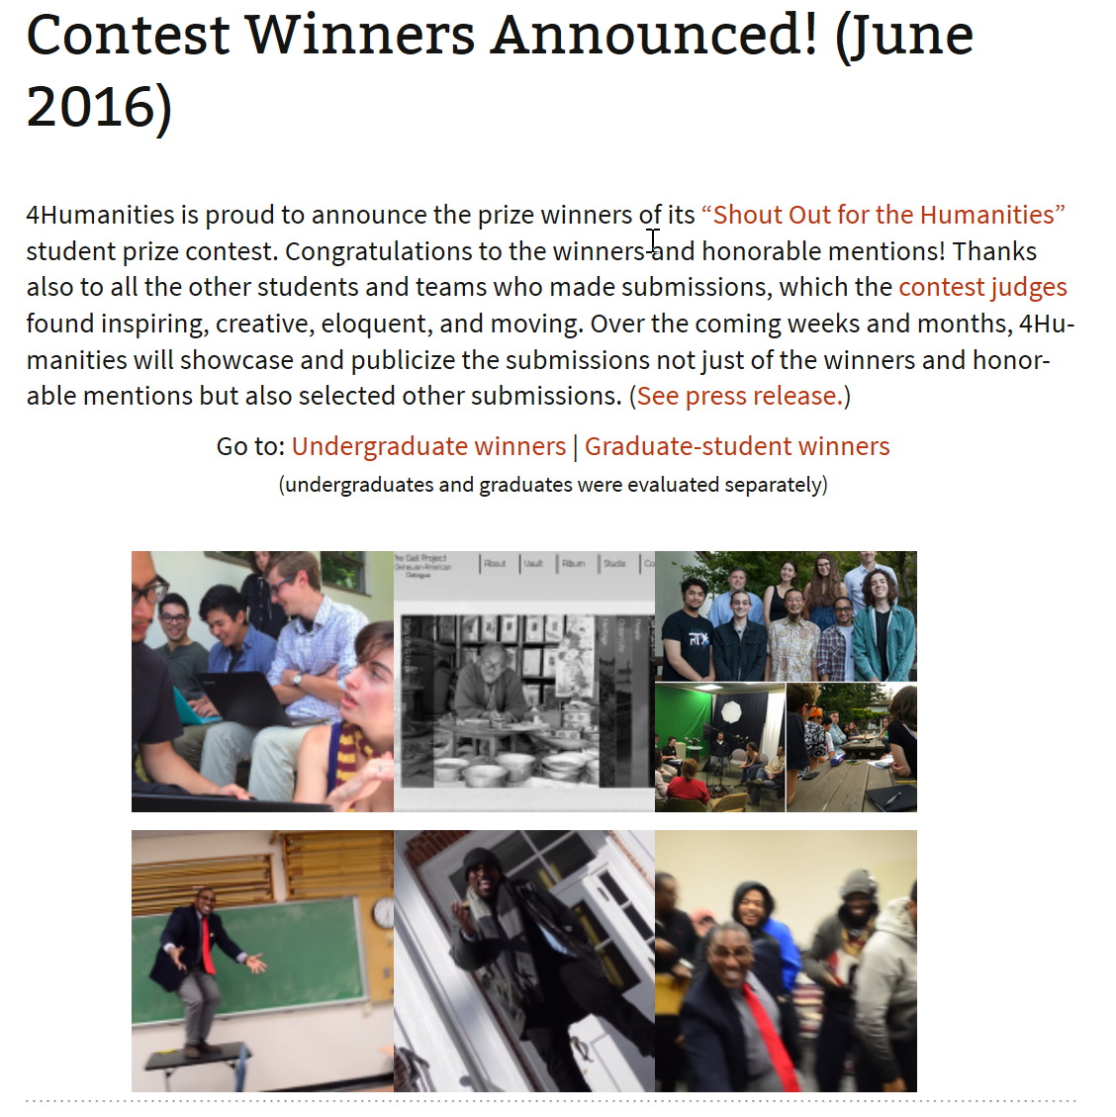
4Humanities.org
Research-driven Advocacy
Digital Humanities Methods
Contest Workshops
Contest Judges
Contest Kit

Slide 5
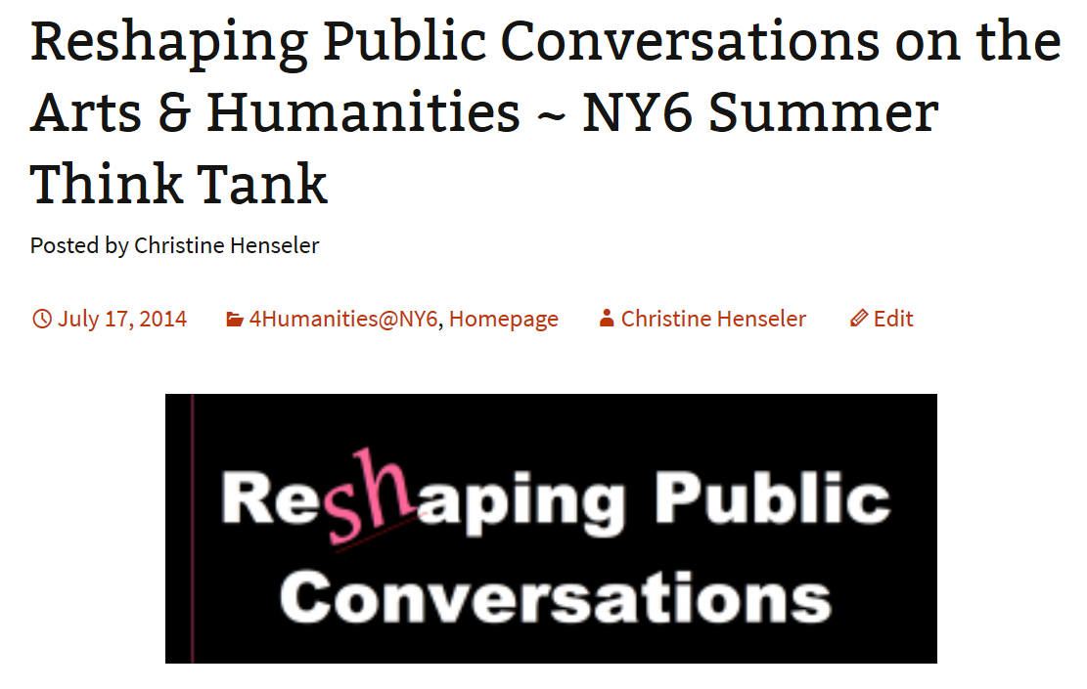
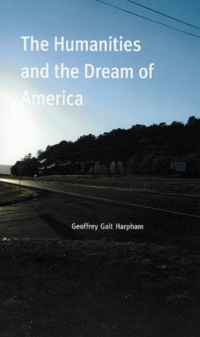
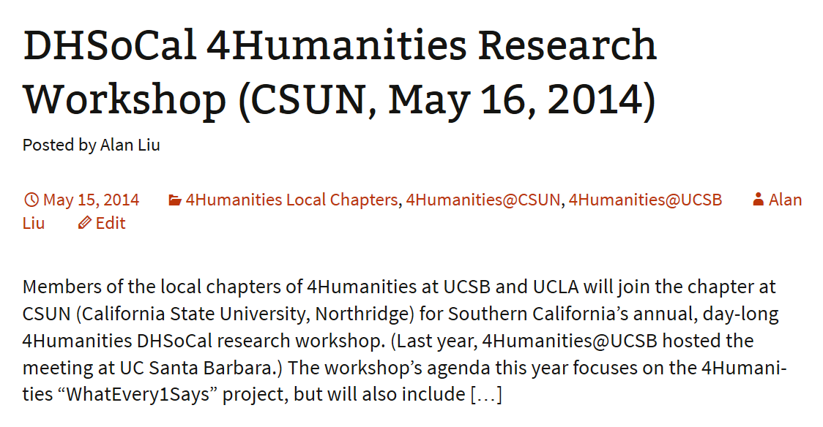
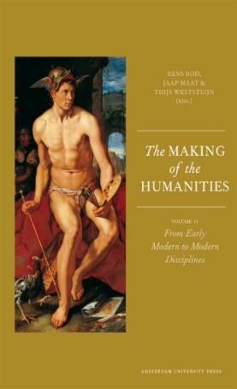
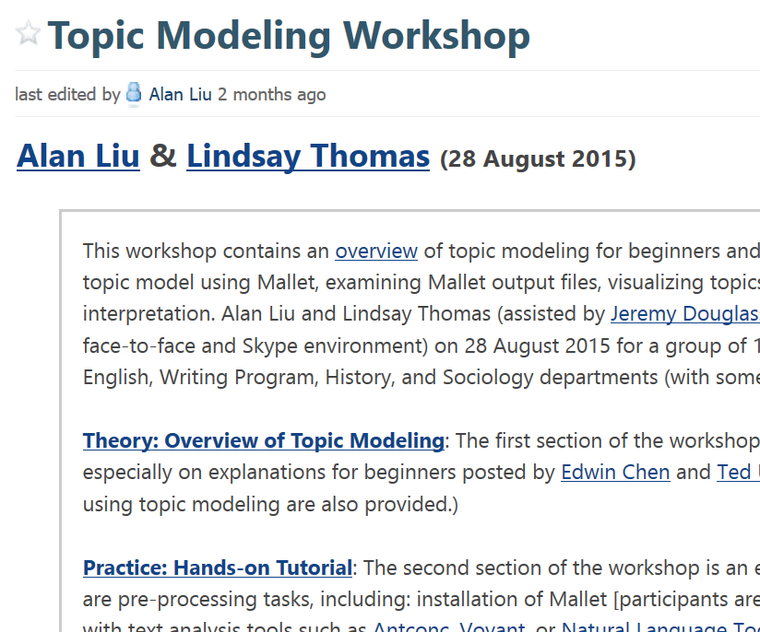
4Humanities.org
Research-driven Advocacy
Digital Humanities Methods
Summer Think Tank
4Hum@NY6, 2014
Discussion meetings at
4Hum@UCSB, 4Hum@NY6
DH Workshops
Global Humanities Colloquium
4Hum@UCSB, 3/12/14

Slide 6
4Humanities.org
Research-driven Advocacy
Digital Humanities Methods
Pilot Project, 2013-2016
~36,000 articles from New York Times, Washington Post, Wall Street Journal, Los Angeles Times, USA Today, NPR, The Guardian, etc.
Summer 2017 Bridge Work
Scoping work
Research reports
Data source research
Identifying collection targets

Slide 7
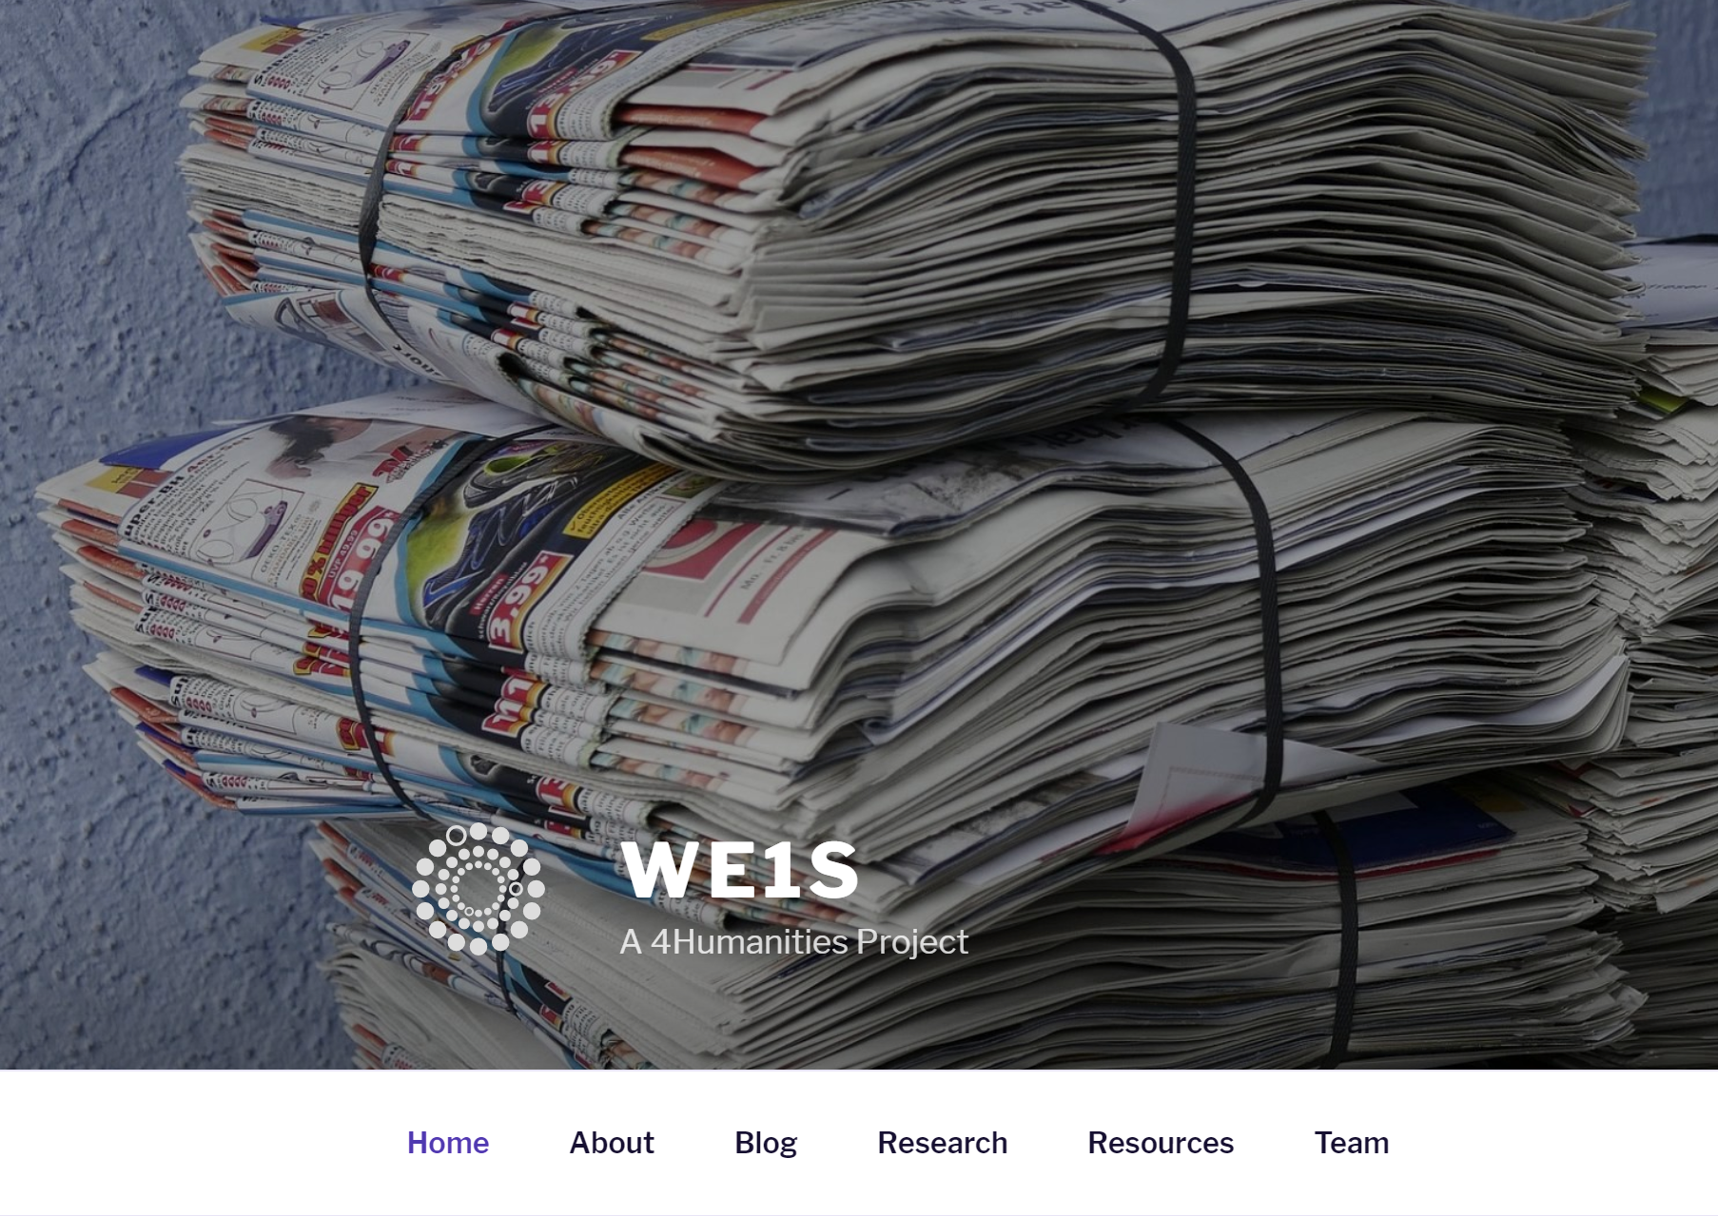
“WhatEvery1Says” (WE1S)
Big Data Analysis of Public Discourse on the Humanities
The Andrew W. Mellon Foundation, $1.1M (2017-2020)
UCSB -- PI, Alan Liu; co-PI, Jeremy Douglass
California State U., Northridge -- co-PI. Scott Kleinman (subgrantee)
U. Miami --co-PI, Lindsay Thomas (subgrantee)

Slide 8
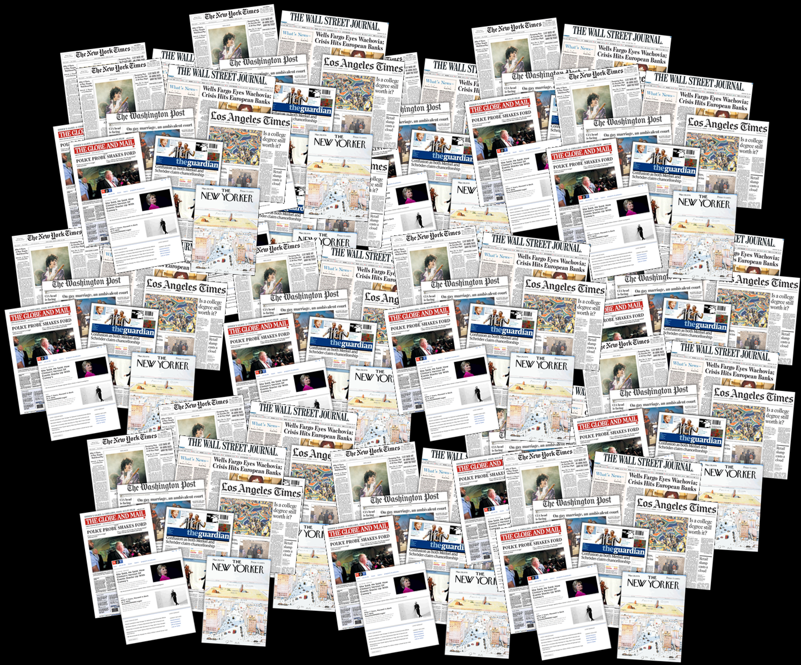
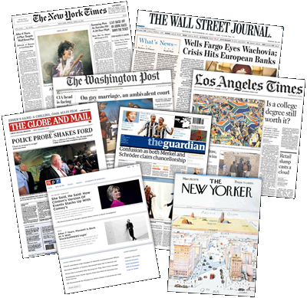

Slide 9
Research Goals & Methods

Slide 10
Research Goals & Methods
Collect a representative national and international big-data corpus of journalistic and other public discourse related to the humanities.
Use topic modeling, word embedding, and other text analysis methods to model themes, frames of discussion, value terms, and rhetoric/narratives of such discourse.

Slide 11
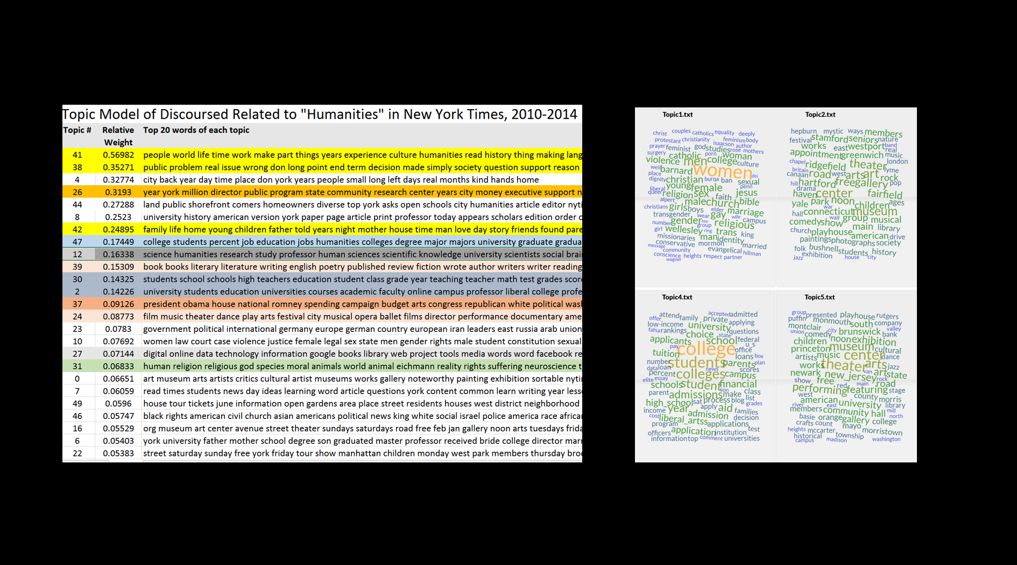
Topic model of articles in New York Times mentioning “humanities” in 2014

Slide 12
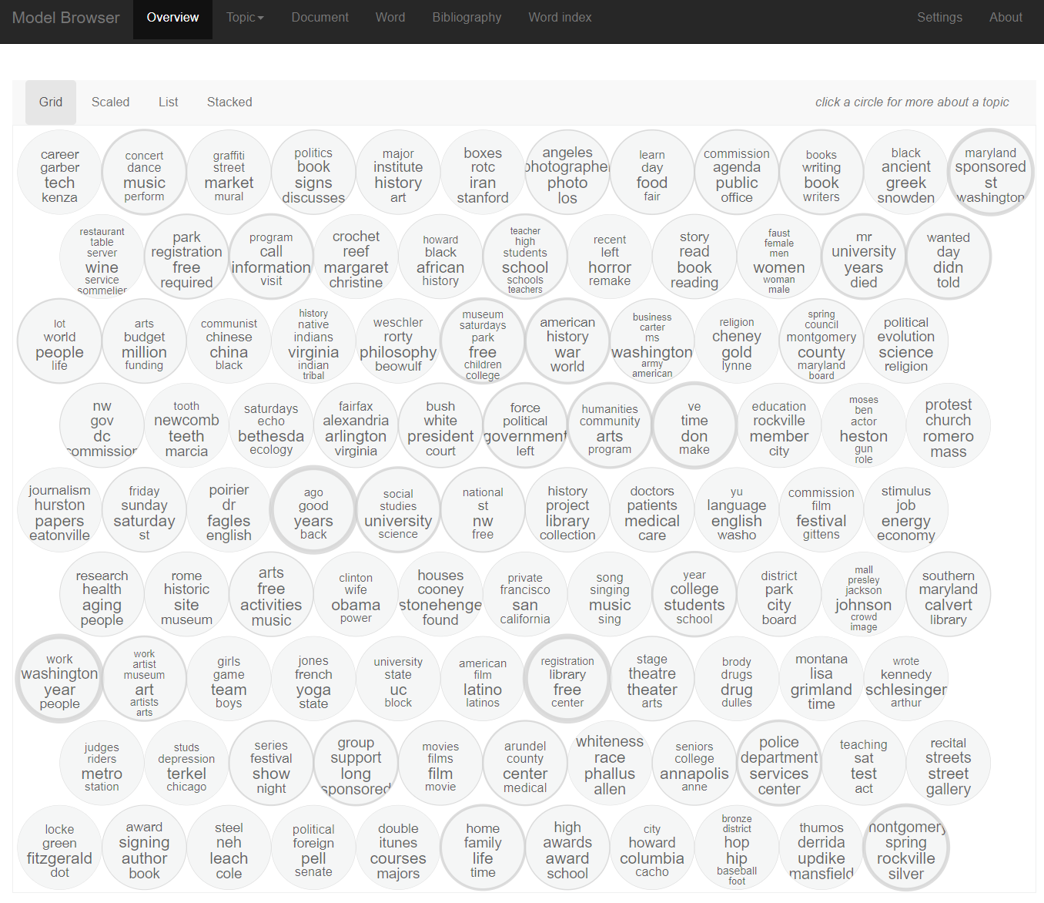
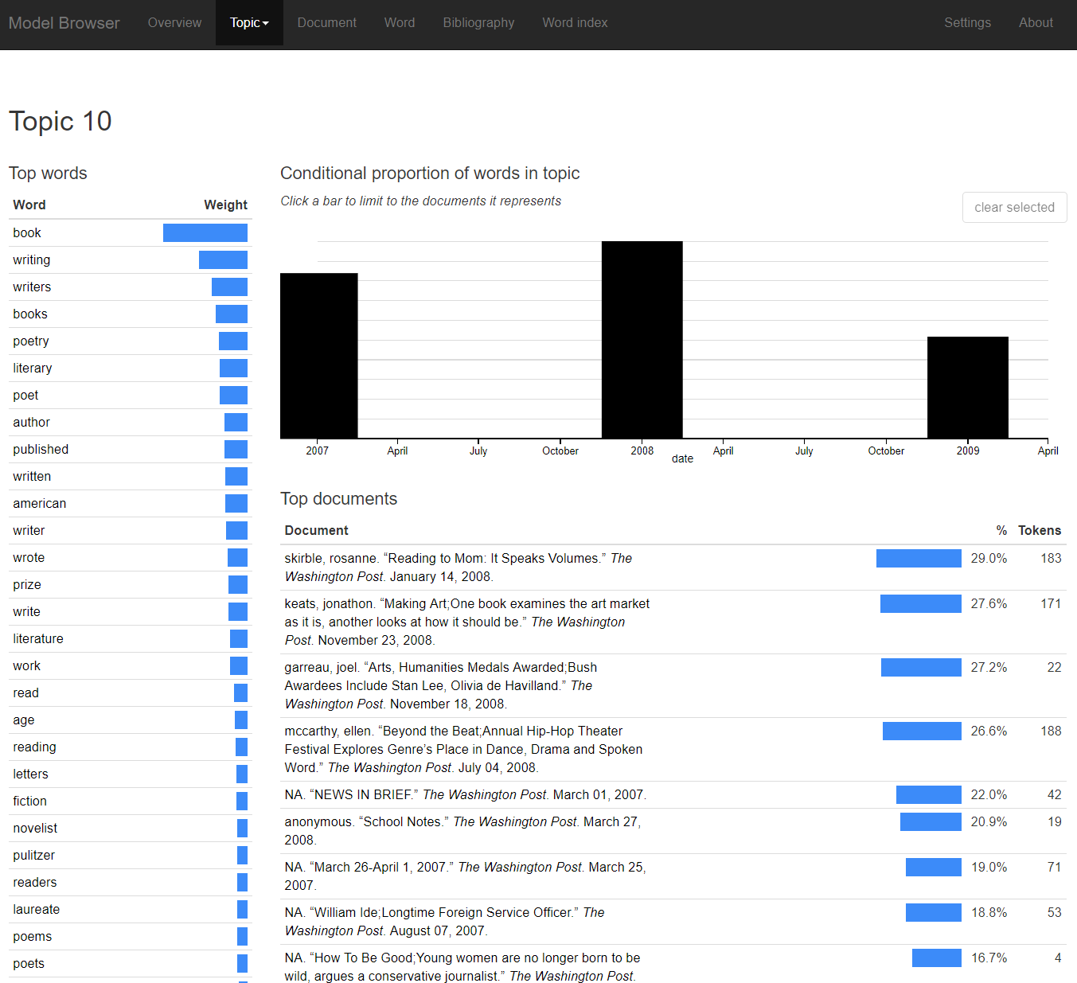
Andrew Golstone’s dfr-browser
(other topic modeling platforms & interfaces)
Topic model of articles in Washington Post & Los Angeles Times, 2007-2009
Link

Slide 13
Research Goals & Methods
Collect a representative national and international big-data corpus of journalistic and other public discourse related to the humanities.
Use topic modeling, word embedding, and other text analysis methods to model themes, frames of discussion, value terms, and rhetoric/narratives of such discourse.
Study the way racial, ethnic, gender, 1st-generation (college or immigrant), and other groups are positioned by media, or position themselves in the media, in relation to the humanities.
Study the relation between academic disciplinary ideas of the humanities and broader ideas of the humanities in culture.

Slide 14
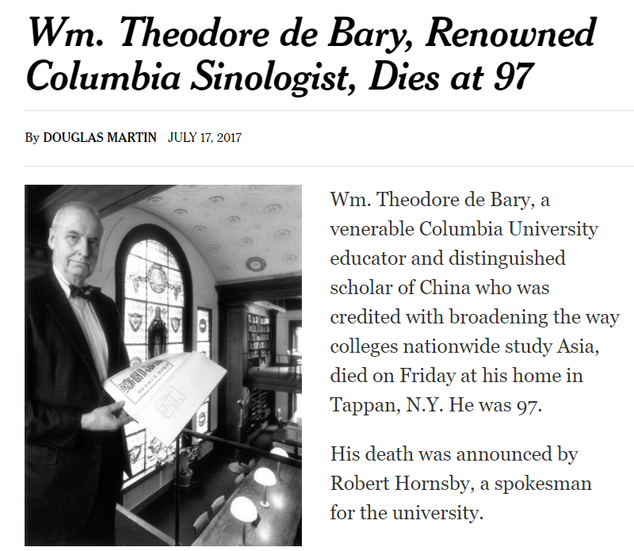

Slide 15
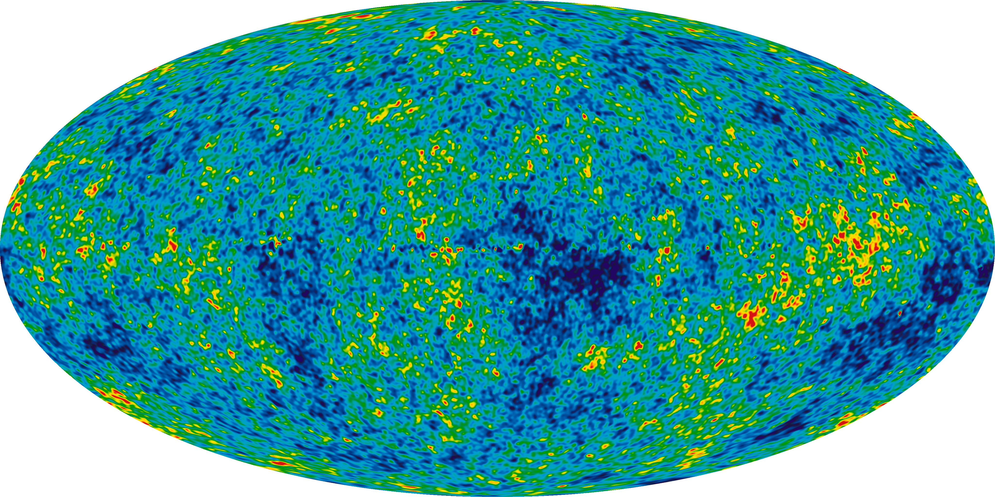
Comparison with a “Random Corpus”

Slide 16
Top 10 research questions
the summer team identified
20. Do different ethnic groups hold different conversations about the humanities? Does this differ in the U.S. in comparison with nations abroad?
14. How does public discussion of the humanities trend over time?
17. How are the humanities discussed in relation to different gender groups? (e.g. how are women positioned in relation to the humanities versus men?)
24. What topics tend to coincide with discussions of the humanities? When other topics appear together with the humanities in a text, is their subject matter articulated differently?
12. What are the main frames, narratives, of scenes in which the humanities are discussed (e.g., an economic frame of view, a political frame of view, a frame of view focused on individual life fulfillment, a cultural arts frame of view, etc.)?
13. What are important "synechdoches" of the humanities in public discourse--i.e., common topics, fields, examples, stories that journalists use to "stand for" the humanities?
21. Does the discussion of the humanities change across media types? For instance, do TV news reporters report on the humanities differently than radio hosts or newspaper reporters?
27. What institutions or disciplines are emphasized in public discourse on the humanities? Which institutions receive attention from sources inside vs. outside academia?
28. How does the discourse about the humanities engage multiple institutions simultaneously? In a landscape of businesses, politicians and entertainment, where does humanities fit in? One operationalization: does the conversation look different across the sections of the newspaper?
11. What is the difference, relation, and relative proportion of "background" versus "foreground" discussions of the humanities?

Slide 17
Theory

Slide 18
Theory/Practice Behind Project Methods
Theory/Practice of Intellectual History
Theory/Practice of a “Representative” Corpus
Theory/Practice of Open, Reproducible Digital Humanities Research

Slide 19
Theory/Practice of Intellectual History
Geist
Geistesgeschichte and Wissenschaften

Slide 20
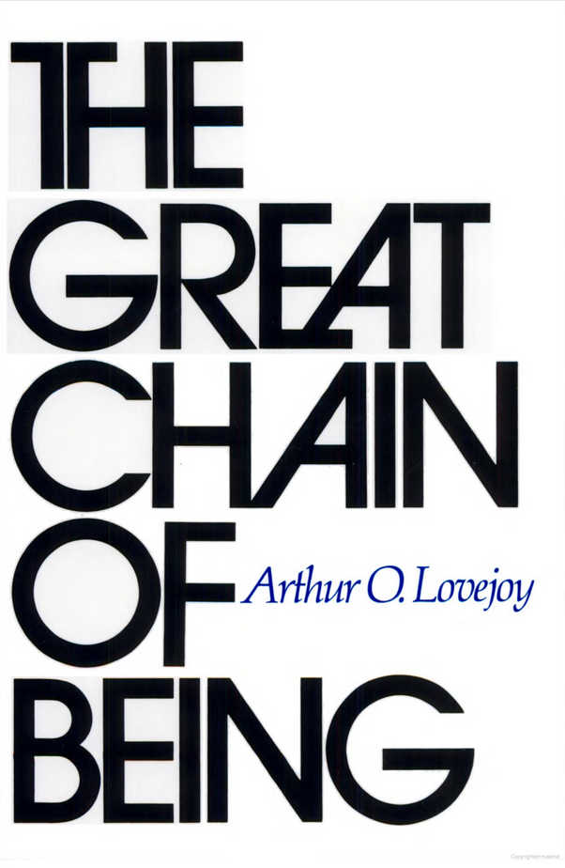
Theory/Practice of Intellectual History
Arthur O. Lovejoy (1936), p. 3:
[History of idea’s] initial procedure may be said — though the parallel has its dangers — to be somewhat analogous to that of analytic chemistry. In dealing with the history of philosophical doctrines, for example, it cuts into the hard-and-fast individual systems and, for its own purposes, breaks them up into their component elements, into what may be called their unit-ideas. The total body of doctrine of any philosopher or school is almost always a complex and heterogeneous aggregate — and often in ways which the philosopher himself does not suspect. It is not only a compound but an unstable compound, though, age after age, each new philosopher usually forgets this melancholy truth. One of the results of the quest of the unit-ideas in such a compound is, I think, bound to be a livelier sense of the fact that most philosophic systems are original or distinctive rather in their patterns than in their components.

Slide 21
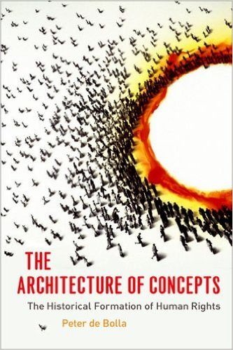
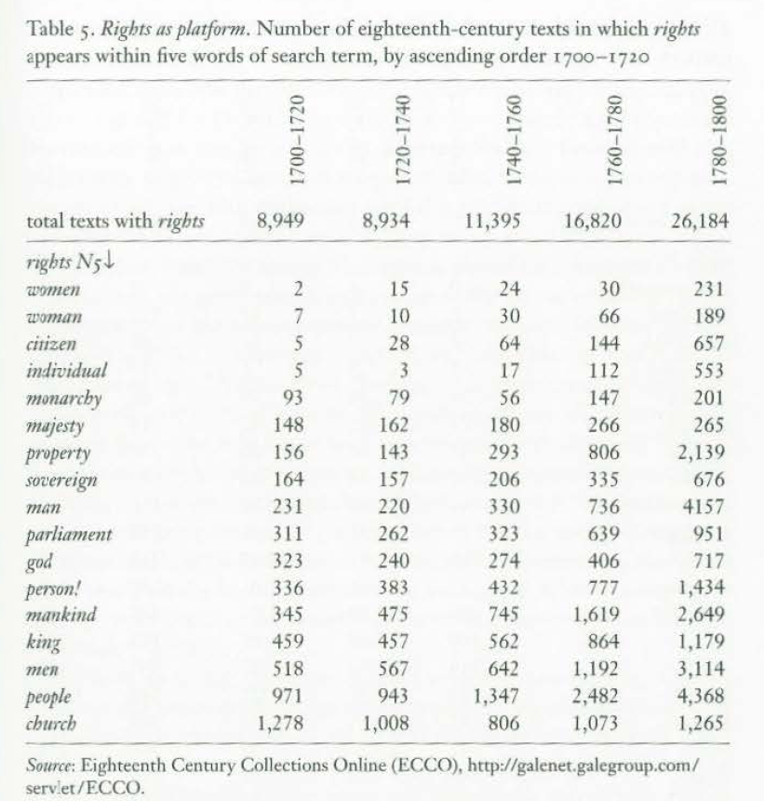
Theory/Practice of Intellectual History
Cambridge Concept Lab
Peter de Bolla (2013)

Slide 22
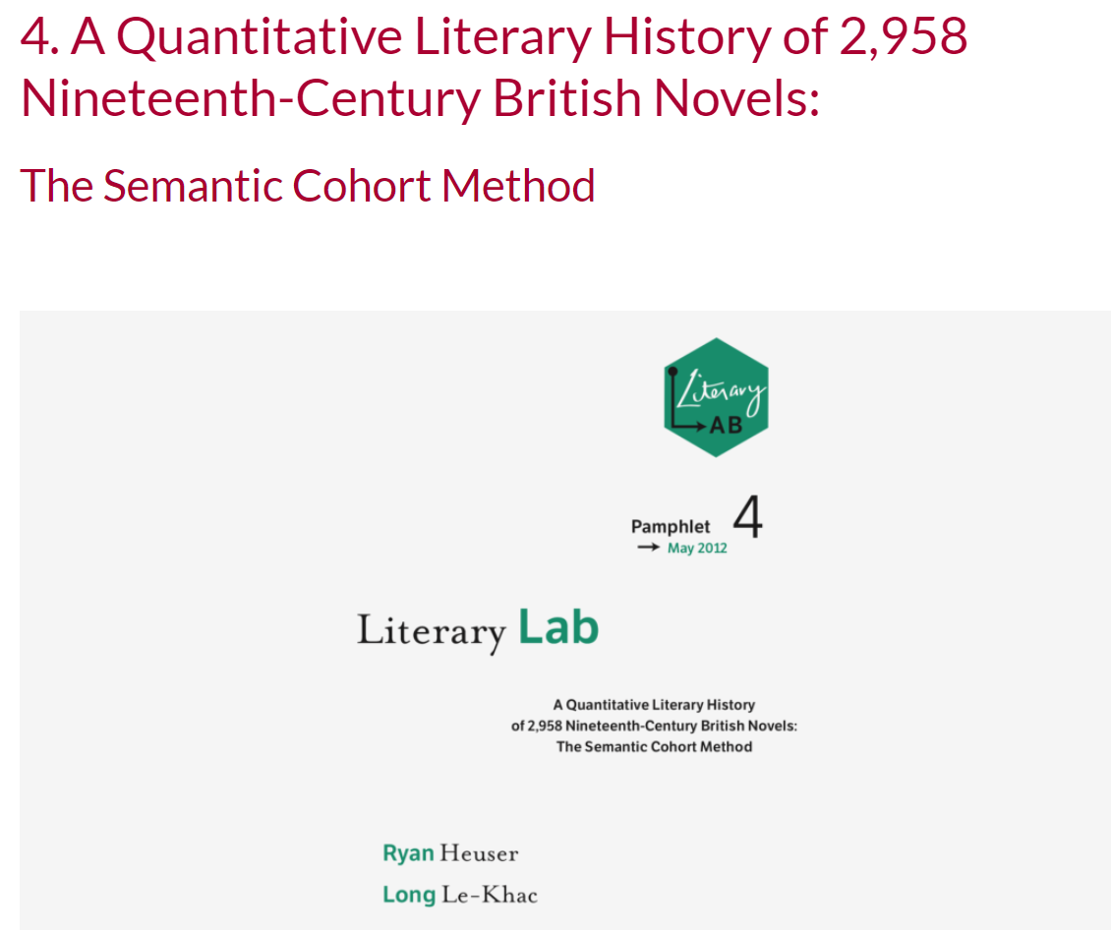
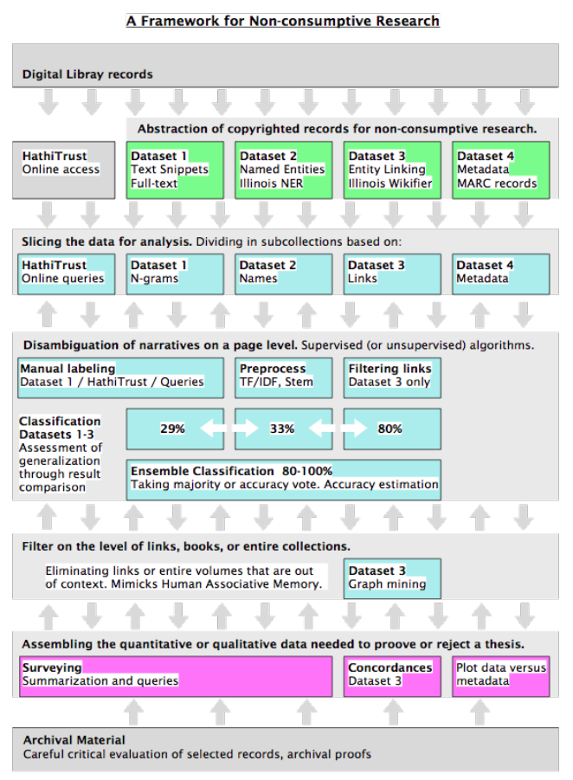
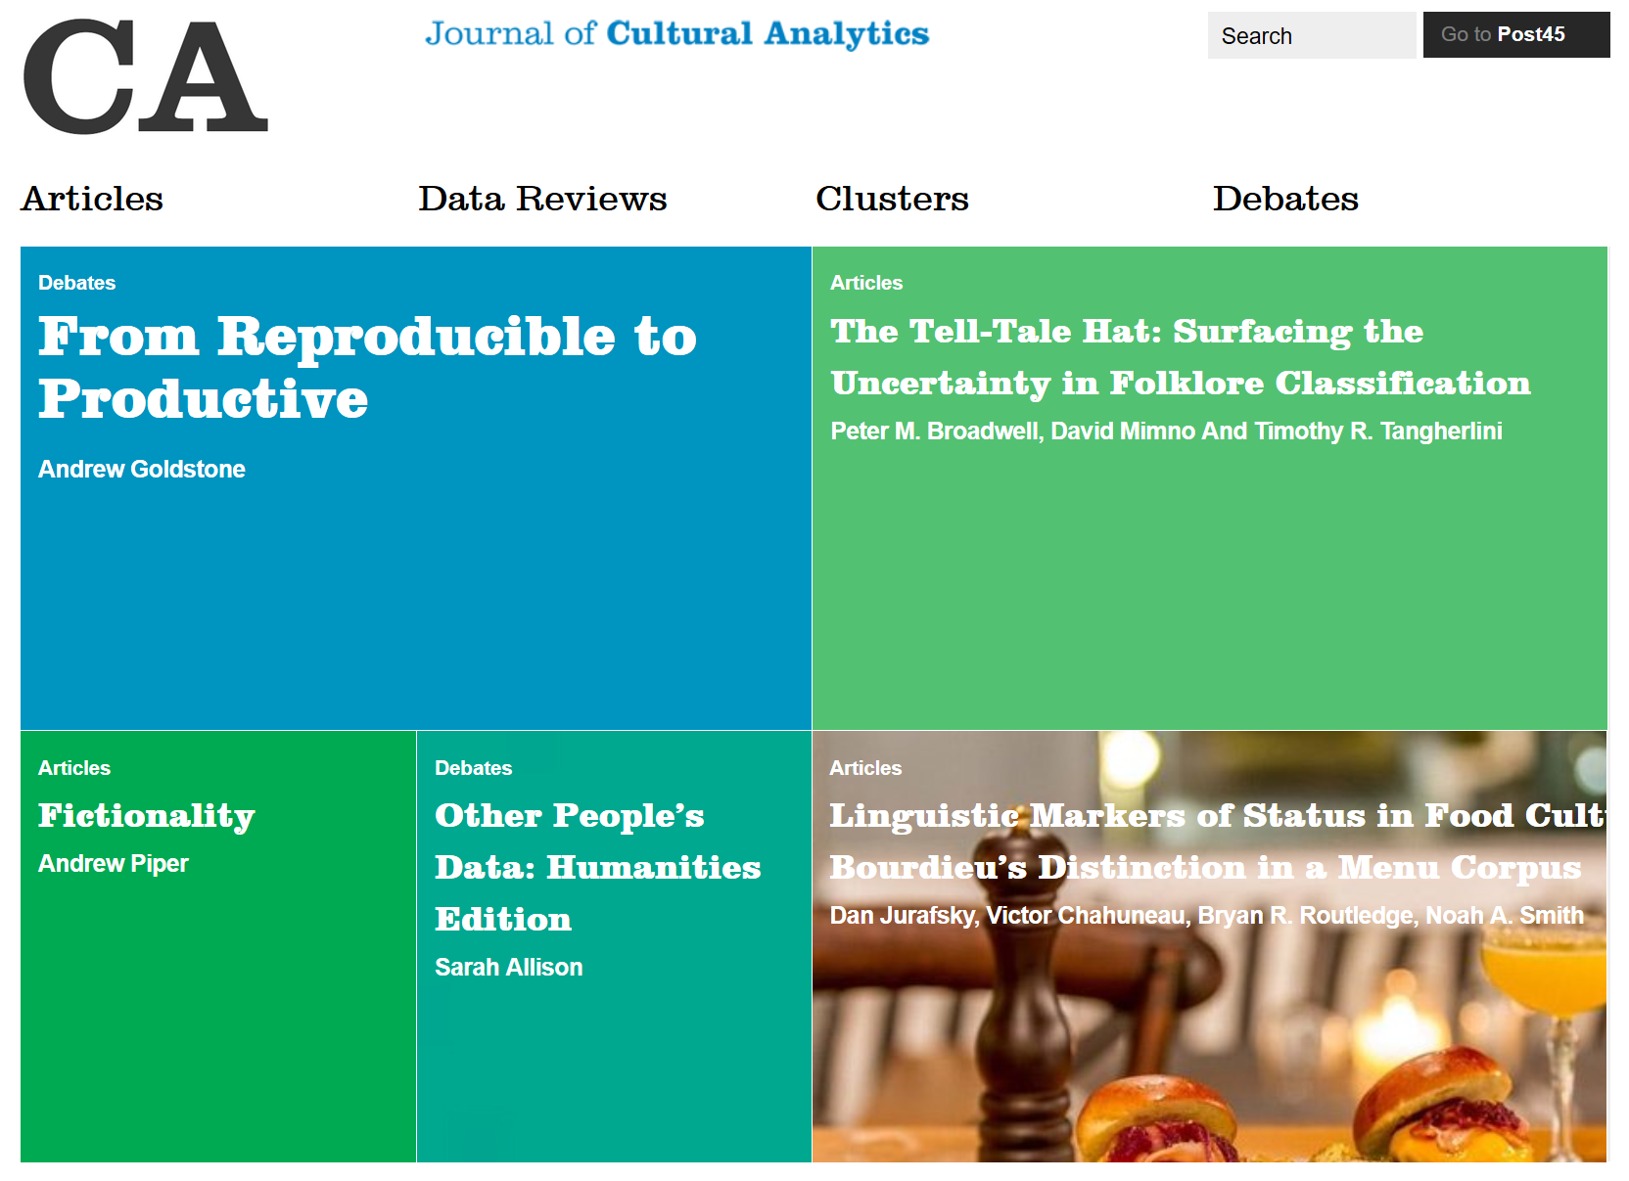
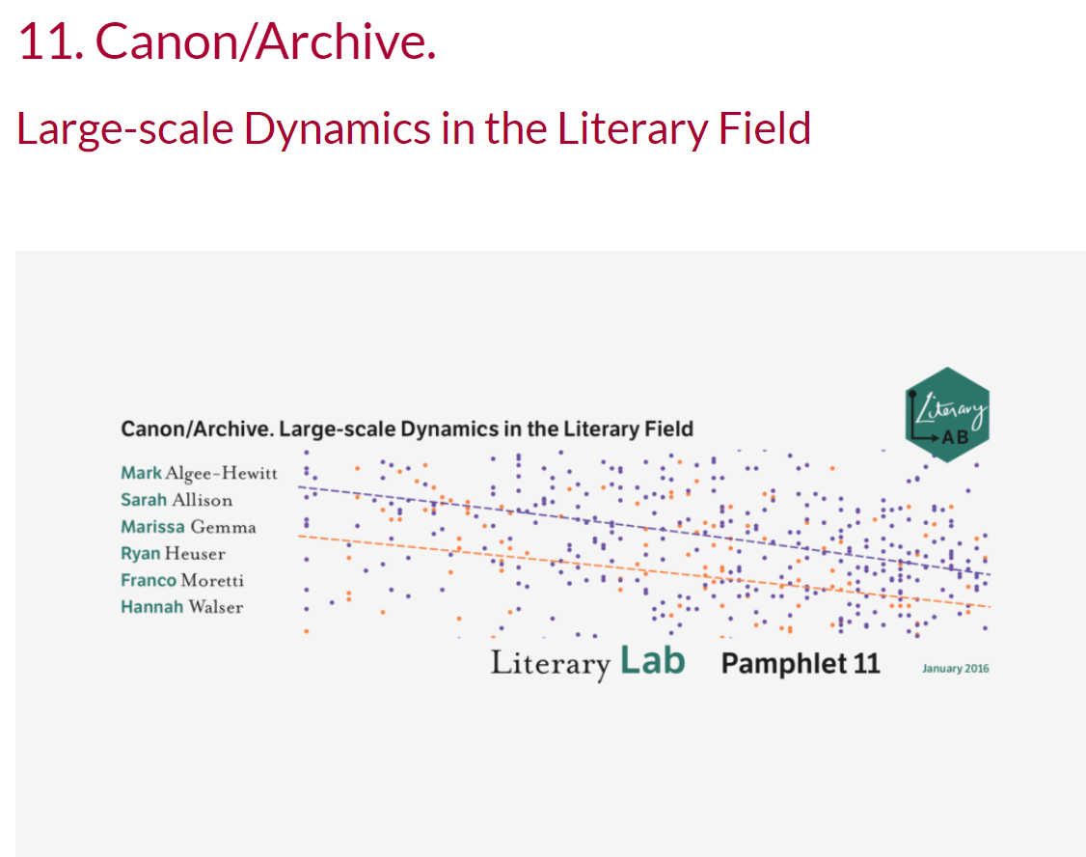
Theory/Practice of Intellectual History
“Digital Humanities”
Journal of Cultural Analytics
Dan Baciu, “The Chicago School: Evolving Systems of Value”
(HTRC ACS Report)
Stanford Literary Lab

Slide 23
Theory/Practice of Intellectual History
Geist
Ideology
History of Ideas
Mentalité
Form
Discourse
Habitus
Structure
Culture
Digital Humanities
(cultural analytics)

Slide 24
Theory/Practice of Intellectual History
Geist
Ideology
History of Ideas
Mentalité
Form
Discourse
Habitus
Structure
Culture
Digital Humanities
(cultural analytics)

Slide 25
Theory/Practice of Intellectual History
Practice
Philology
Close Reading
Distant Reading
“Bags of Words”

Slide 26
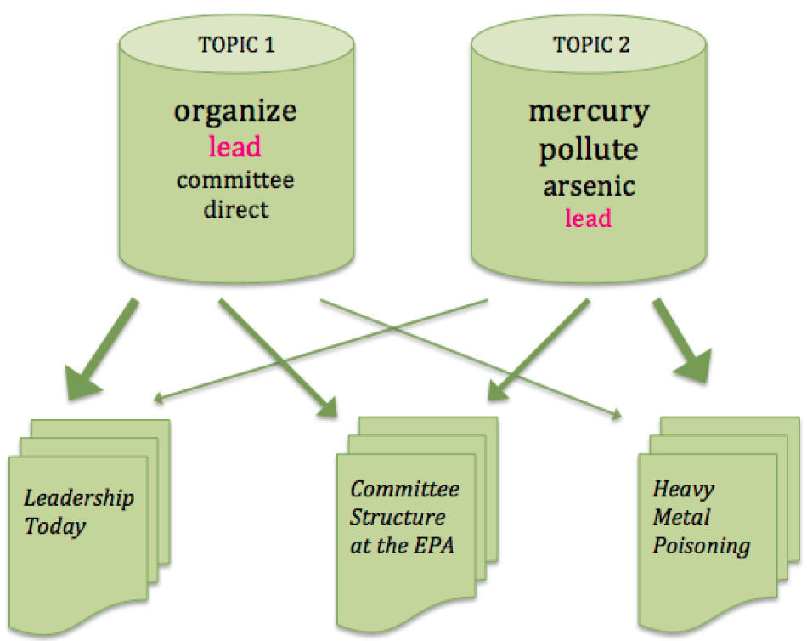
Theory/Practice of Intellectual History
Topic Modeling (simplified)
Ted Underwood
"Topic Modeling Made Just Simple Enough" (2012)
LDA (Latent Dirichlet Allocation)

Slide 27
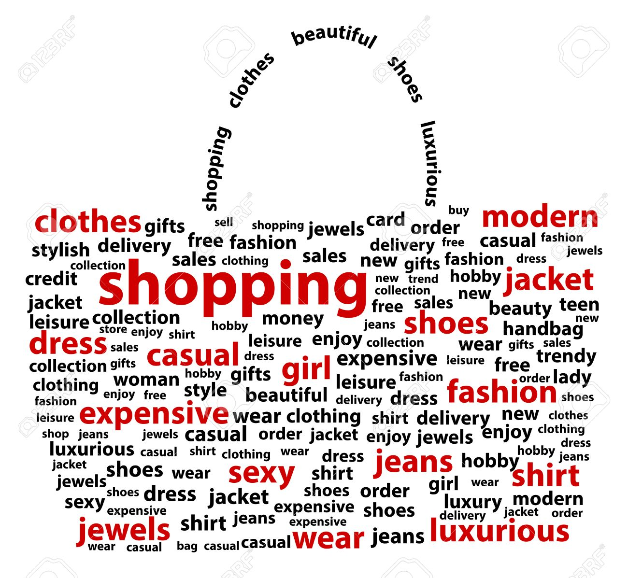
Theory/Practice of Intellectual History
“Bag of words”

Slide 28
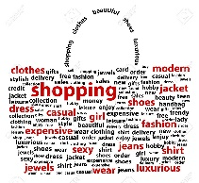
Theory/Practice of Intellectual History
words
words
words
words
words
words
words
words
words
words
words
words
words
words
words
words
words
words
words
words
words
words

Slide 29
Andrew Golstone’s dfr-browser
(other topic modeling platforms & interfaces)
Topic model of articles in Washington Post & Los Angeles Times, 2007-2009
Link

Slide 30
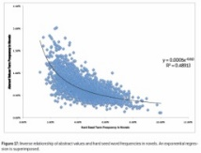
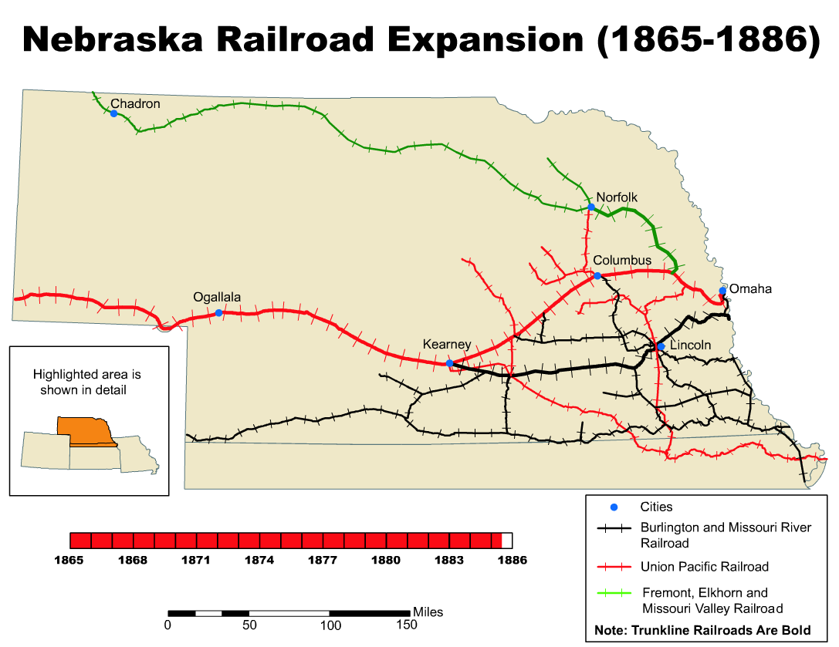
Theory/Practice of Intellectual History
Discrete, Countable Phenomena
(e.g., words, names)
Spatial Pattern
Diagrams
Maps
Temporal Pattern
Trends
Narratives
1
Aggregate
Phenomena
(spreadsheet or database)
2
3
Fitted to middle-level phenomena (e.g., genres, classes)
4
5
Middle level used to mediate micro & macro (e.g., “close reading” & “culturomics”)
“Meaning”

Slide 31
Theory/Practice of Intellectual History
Linguistic formulae or schemata
“a new X” . . . “beyond X” . . . “an X crisis” . . . “what is wrong with X” . . . “man does not live by X alone” . . . “X: CEO” . . . “global X” . . . “keep calm and X on” . . . “I majored in X and Y”
Daniel Shore, Cyberformalism: Histories of Linguistic forms in the Digital Archive (2018)
“gnomē, sententiae, commonplaces, adages, proverbs, mottos, sayings, saws, aphorisms,… maxims,… clichés, catchphrases, slogans, phrasemes, listemes….” (9)
“lexically open, partially filled, and unfilled constructions;,… abstract, and schematic constructions; schemata … ; formal, variable, and constructional idioms; syntactic patterns, phrasal patterns, phrasal templates “ (7)

Slide 32
Theory/Practice of Intellectual History
“Architecture of Concepts”
Cambridge Concept Lab
Peter de Bolla (2013)

Slide 33
Theory/Practice of Intellectual History
“I propose five categories for [a typology of concepts]: kind, function, structure, modality, and phase. In addition . . . I also outline three architectural elements that enable different ways of connecting concepts in a network: the hinge, the deposit, and the platform.” (32)
Cambridge Concept Lab

Slide 34
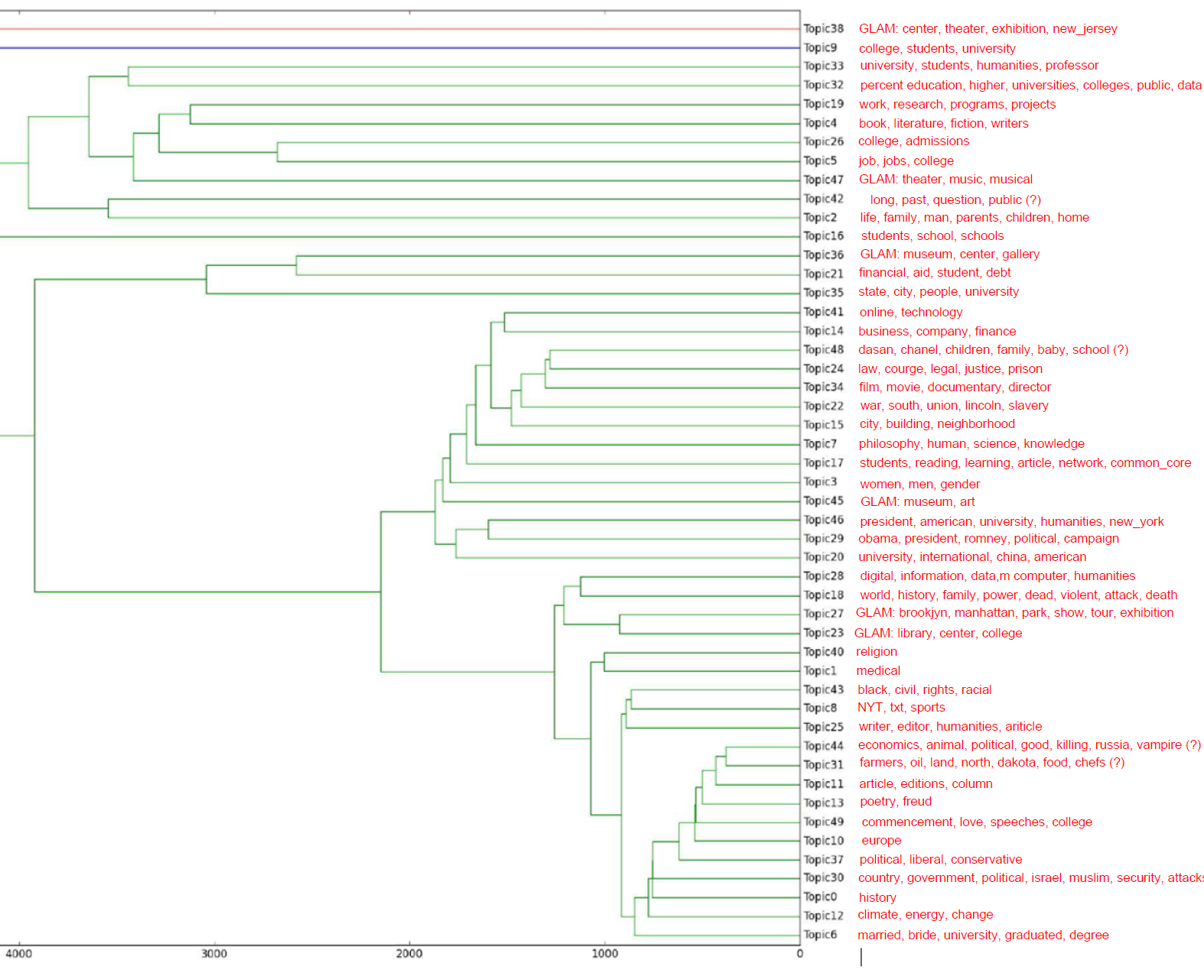
Theory/Practice of Intellectual History
Topic Models
Hierarchical dendogram topic clustering

Slide 35
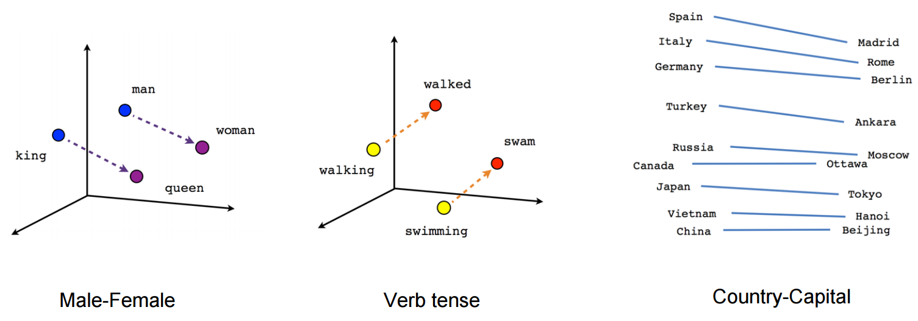
Theory/Practice of Intellectual History
Word Embedding

Slide 36
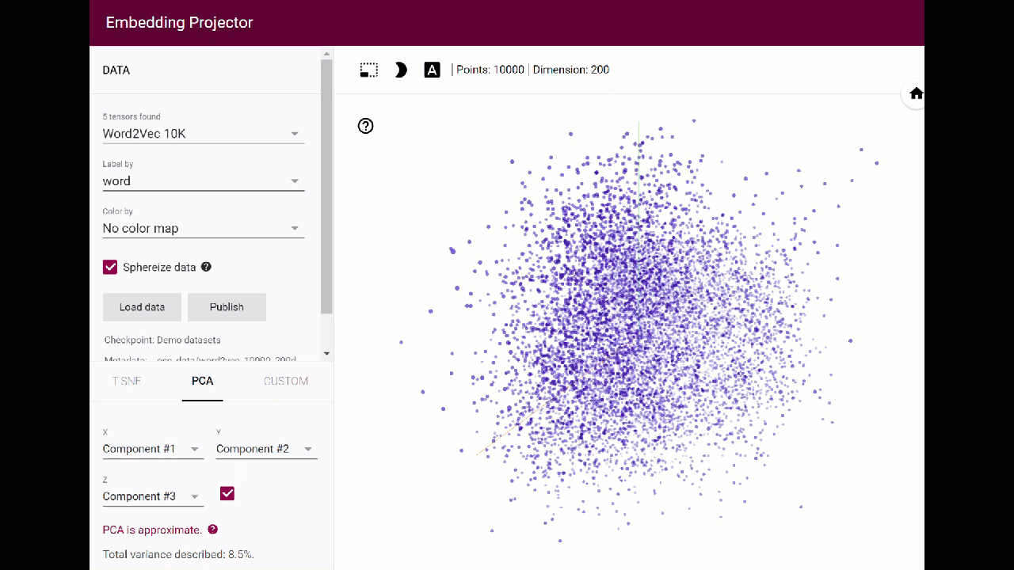
Theory/Practice of Intellectual History
Word Embedding

Slide 37
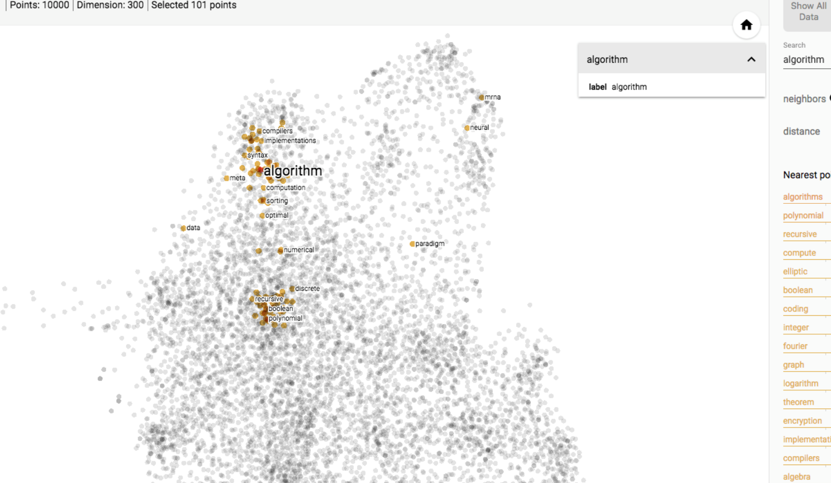
Theory/Practice of Intellectual History
Word Embedding
E-mail from WE1S T-Hackers group:
“Attached is a screenshot for the keyword "algorithm", using a 100 million word Wikipedia corpus, and T-SNE dimensionality reduction . You can see a very nice clustering which allows us to separate "implementation" terms ("compiler"), "theory" terms ("polynomial"), and "philosophy" terms (“paradigm”). “

Slide 38
Theory/Practice of Intellectual History
“Frame” Analysis George Lakoff, "Framing 101: How to Take Back Public Discourse”
Metaphors
Scenarios
Anecdotes
Evidence
Infographics

Slide 39
Advocacy Outputs

Slide 40
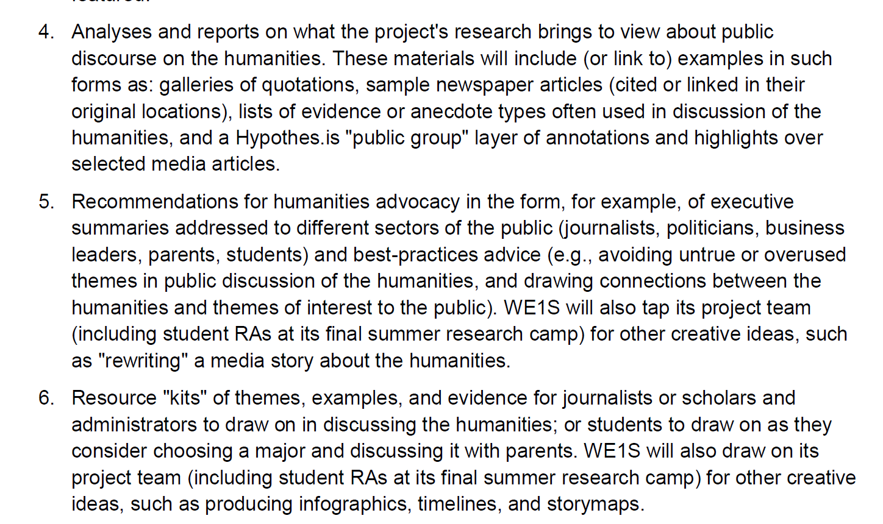
Advocacy Outputs

Slide 41
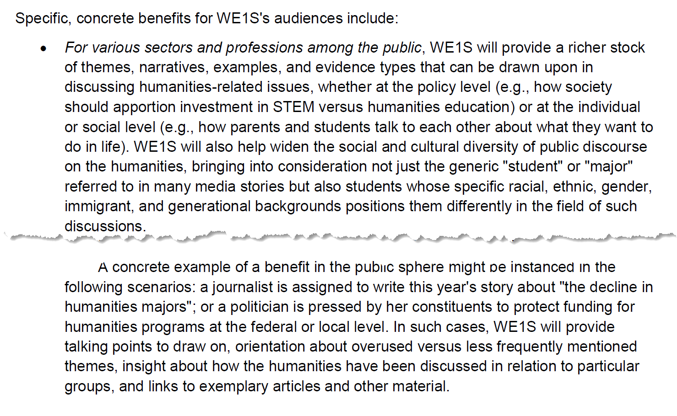
Advocacy Outputs

Slide 42
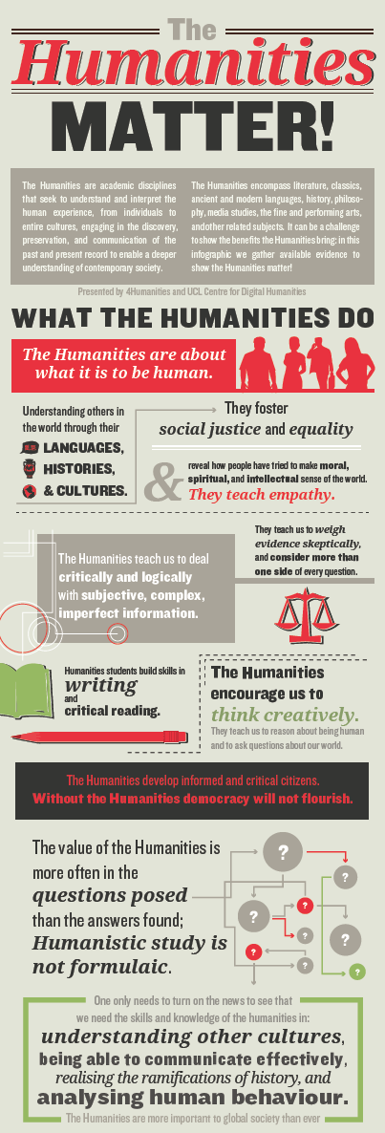
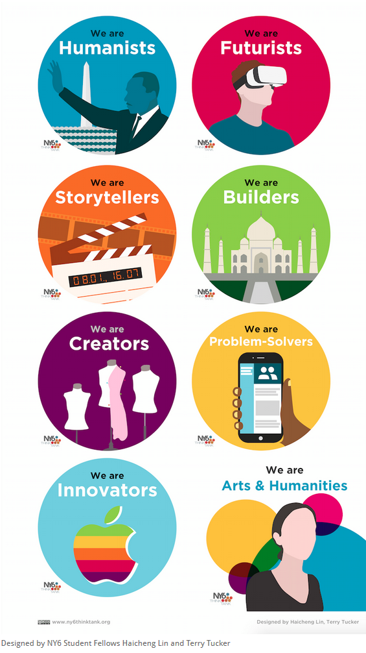
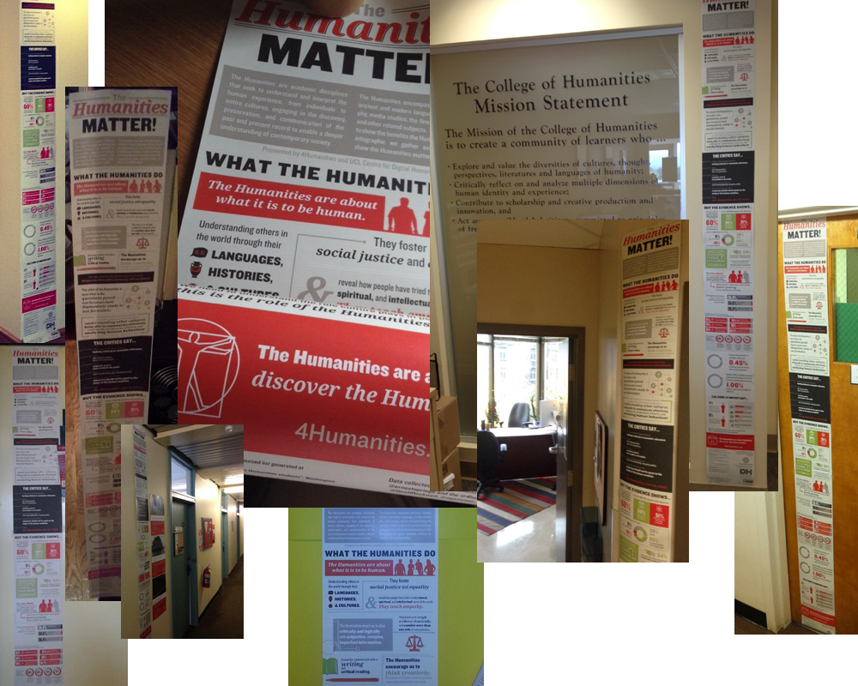
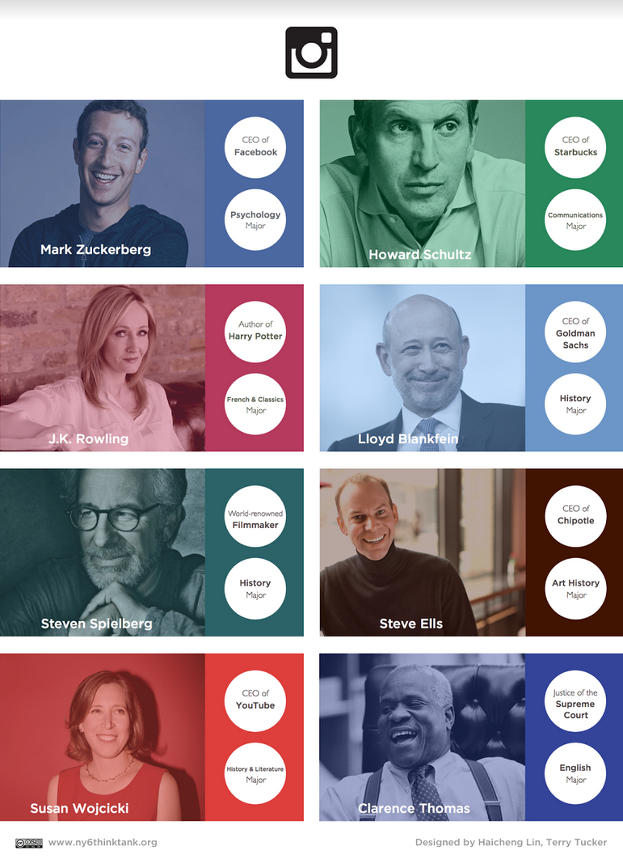
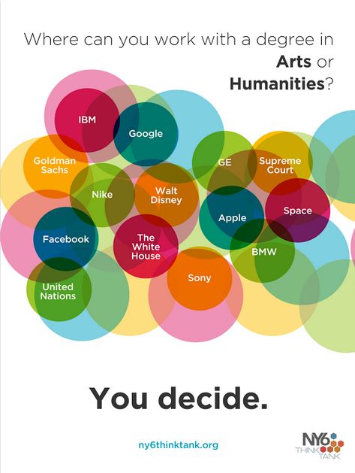
Advocacy Outputs

Slide 43
Research Outputs

Slide 44
Research Outputs
Authoring and co-authoring opportunities for:
Reports, analyses, blog posts on we1s.ucsb.edu (bylined)
Conference presentations
Articles
Supplements to individual student dissertation research

